Slide 1
Nouns
Dylan Hancey
Julissa Wade
Ryan Brennan

Slide 2
Lets watch a short video…
https://www.youtube.com/watch?v=Qk4N5kkifGQ

Slide 3
As a subject of a sentence:
Every sentence must have a subject.
Decide which part is the subject.

Slide 4
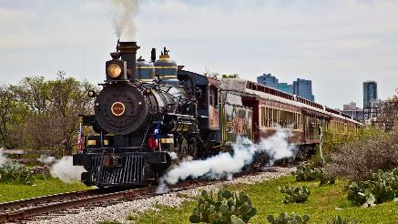
For example…
A train travels at high speeds.
Before visiting the library, Stephen did considerable research online.
Green balloons are better than green boogers.
train
Stephen
balloons

Slide 5
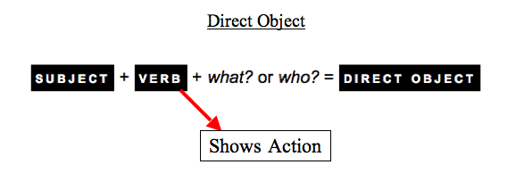
As the direct object of a transitive verb:
A direct object is a word or a group of words representing the person or thing upon which the action of a verb is performed or toward which it is directed.

Slide 6
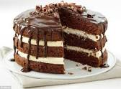
For example…
Our cat caught a mouse.
After dinner, Matthew always serves a cake.
George the ape ate Mort the banana man.
mouse
cake
Mort

Slide 7
As the predicate nominative of a linking verb:
A predicate nominative is a noun or pronoun that follows a linking verb and refers to the subject of the verb.
Typically, a predicate nominative has the same value or grammatical weight as the subject.

Slide 8
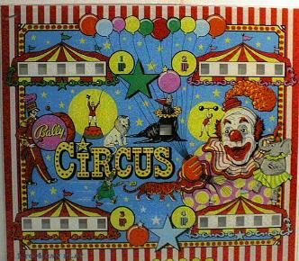
For example…
At the end of the tournament, Tiger Woods was the leader.
The assistant’s attitude seems a mystery to everyone involved.
The circus folk love finding lost shoes. (It’s a gerund)
leader
mystery
finding

Slide 9
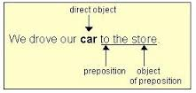
As the object of a preposition:
The object of a preposition is usually (but not always) the noun or pronoun found immediately to the right of the preposition.

Slide 10
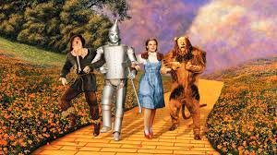
For example…
“Toto, I’ve got a feeling we’re not in Kansas anymore” (Dorothy in The Wizard of Oz, 1939).
The cat ran under the car.
Po the panda’s meal of orange chicken was delicious.
Kansas
car
orange chicken

Slide 11
As a possessive or modifier of another noun:
Possessive relates or denotes the case of nouns and pronouns expressing possession.
Modifier is a word that restricts or adds to the sense of a head noun.

Slide 12
For example…
The cat’s tuna was finally finished.
After a month’s work she earned 500 dollars.
The dog’s toy is hidden deep underground.
cat’s
month’s
dog’s

